Slide 1
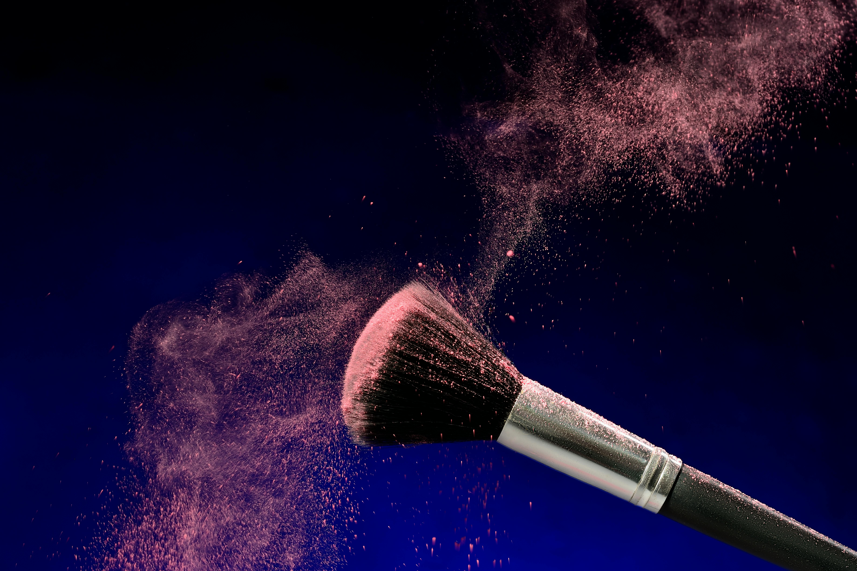
INTRODUCTION:
GLAM
ISTRY
“Glamistry is a beauty and jewelry brand crafted for the modern trendsetter. From stunning lipsticks to delicate jewelry pieces, Glamistry brings glamour and chemistry together to enhance every look.”
~Where Glamour Meets Artistry~

Slide 2
WHY CHOOSE GLAMISTRY?
INTRODUCTION:
✨ Elegant Aesthetic – Our designs and visuals are crafted to make you feel like luxury is within reach. 💄 High-Quality Products – Every formula is developed to be rich, long-lasting, and skin-loving. 💎 Jewelry Meets Glam – A unique blend of cosmetics and jewelry under one brand, styled to perfection. 📱 User-Friendly Website – A smooth, modern online store built to give you a boutique-like experience. 🌟 Empowering Philosophy – We celebrate individuality, confidence, and bold self-expression in everything we create. 🤍 By You, For You – Inspired by modern beauty lovers like you — we’re always evolving with your style.
GLAM
ISTRY
“Glamistry is a beauty and jewelry brand crafted for the modern trendsetter. From stunning lipsticks to delicate jewelry pieces, Glamistry brings glamour and chemistry together to enhance every look.”
~Where Glamour Meets Artistry~

Slide 3
WHY CHOOSE GLAMISTRY?
INTRODUCTION:
✨ Elegant Aesthetic – Our designs and visuals are crafted to make you feel like luxury is within reach. 💄 High-Quality Products – Every formula is developed to be rich, long-lasting, and skin-loving. 💎 Jewelry Meets Glam – A unique blend of cosmetics and jewelry under one brand, styled to perfection. 📱 User-Friendly Website – A smooth, modern online store built to give you a boutique-like experience. 🌟 Empowering Philosophy – We celebrate individuality, confidence, and bold self-expression in everything we create. 🤍 By You, For You – Inspired by modern beauty lovers like you — we’re always evolving with your style.
GLAM
ISTRY
“Glamistry is a beauty and jewelry brand crafted for the modern trendsetter. From stunning lipsticks to delicate jewelry pieces, Glamistry brings glamour and chemistry together to enhance every look.”
~Where Glamour Meets Artistry~
THE KEY FEATURES OF OUR WEBSITE:
Our HomePage:
“A visual gateway into the world of Glamistry — showcasing our signature style, latest collections, and a smooth path to explore everything we offer.”
IDHAR HOMEPAGE KI PIC AYEGI

Slide 4
AAAAA
THE KEY FEATURES OF OUR WEBSITE:
THE KEY FEATURES OF OUR WEBSITE:
WHY CHOOSE GLAMISTRY?
Our HomePage:
Login/Signup Form:
✨ Elegant Aesthetic – Our designs and visuals are crafted to make you feel like luxury is within reach. 💄 High-Quality Products – Every formula is developed to be rich, long-lasting, and skin-loving. 💎 Jewelry Meets Glam – A unique blend of cosmetics and jewelry under one brand, styled to perfection. 📱 User-Friendly Website – A smooth, modern online store built to give you a boutique-like experience. 🌟 Empowering Philosophy – We celebrate individuality, confidence, and bold self-expression in everything we create. 🤍 By You, For You – Inspired by modern beauty lovers like you — we’re always evolving with your style.
“A visual gateway into the world of Glamistry — showcasing our signature style, latest collections, and a smooth path to explore everything we offer.”
A simple and secure gateway for users to access their Glamistry accounts — whether they’re returning customers or new beauties signing up.
IDHAR HOMEPAGE KI PIC AYEGI
IDHR login- idhr signup
KI PIC Aygi-ki pic aygi

Slide 5

AAAAA
THE KEY FEATURES OF OUR WEBSITE:
Our Shipping Form:
“A beautifully styled from that makes ordering easy, quick, and seamless - all while matching the chic vibe of our brand”.
IDHR shippinForm KI PIC AYEGI
THE KEY FEATURES OF OUR WEBSITE:
Login/Signup Form:
A simple and secure gateway for users to access their Glamistry accounts — whether they’re returning customers or new beauties signing up.
IDHR login- idhr signup
KI PIC Aygi-ki pic aygi
THE KEY FEATURES OF OUR WEBSITE:
Our HomePage:
“A visual gateway into the world of Glamistry — showcasing our signature style, latest collections, and a smooth path to explore everything we offer.”
IDHAR HOMEPAGE KI PIC AYEGI

Slide 6
AAAAA
THE KEY FEATURES OF OUR WEBSITE:
Contact Us & FAQ’s:
“Have questions? Our Contact page and FAQ section are designed to assist you with clarity, care, and confidence — just like our products.”
IDHR contactpage KI PIC AYEGI
THE KEY FEATURES OF OUR WEBSITE:
THE KEY FEATURES OF OUR WEBSITE:
Our Shipping Form:
Login/Signup Form:
“A beautifully styled from that makes ordering easy, quick, and seamless - all while matching the chic vibe of our brand”.
A simple and secure gateway for users to access their Glamistry accounts — whether they’re returning customers or new beauties signing up.
IDHR shippinForm KI PIC AYEGI
IDHR login- idhr signup
KI PIC Aygi-ki pic aygi

Slide 7
AAAAA
THE KEY FEATURES OF OUR WEBSITE:
User Panel:
A personalized space where users can track orders, manage their profile, view saved items, and enjoy a seamless shopping experience, all in one elegant dashboard.
IDHR userPanel KI PIC AYEGI
THE KEY FEATURES OF OUR WEBSITE:
THE KEY FEATURES OF OUR WEBSITE:
Our Shipping Form:
Contact Us & FAQ’s:
“A beautifully styled from that makes ordering easy, quick, and seamless - all while matching the chic vibe of our brand”.
“Have questions? Our Contact page and FAQ section are designed to assist you with clarity, care, and confidence — just like our products.”
IDHR shippinForm KI PIC AYEGI
IDHR contactpage KI PIC AYEGI

Slide 8
AAAAA
THE KEY FEATURES OF OUR WEBSITE:
THE KEY FEATURES OF OUR WEBSITE:
Admin Panel:
User Panel:
A secure dashboard where admins can manage products, view orders, update content, and track customer activity — all in one place.
A personalized space where users can track orders, manage their profile, view saved items, and enjoy a seamless shopping experience, all in one elegant dashboard.
IDHR AdminPAnel
KI PIC AYEGI
IDHR userPanel KI PIC AYEGI
THE KEY FEATURES OF OUR WEBSITE:
Contact Us & FAQ’s:
“Have questions? Our Contact page and FAQ section are designed to assist you with clarity, care, and confidence — just like our products.”
IDHR contactpage KI PIC AYEGI

Slide 9
AAAAA
THE KEY FEATURES OF OUR WEBSITE:
THE KEY FEATURES OF OUR WEBSITE:
THE KEY FEATURES OF OUR WEBSITE:
Our Products:
Admin Panel:
User Panel:
“From luxurious lipsticks to elegant jewelry, each product is displayed with vibrant visuals, star ratings, and pricing — designed to catch the eye and win the heart.”
A secure dashboard where admins can manage products, view orders, update content, and track customer activity — all in one place.
A personalized space where users can track orders, manage their profile, view saved items, and enjoy a seamless shopping experience, all in one elegant dashboard.
IDHR prdctCategorys KI PIC AYEGI
IDHR AdminPAnel
KI PIC AYEGI
IDHR userPanel KI PIC AYEGI

Slide 10

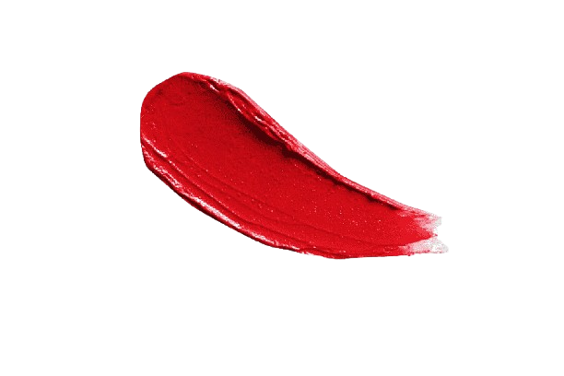
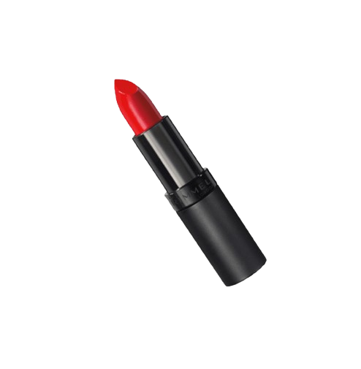

AAAAA
OUR SIGNATURE PRODUCTS:
Crimson Crush Lipstick
A bold, sultry red that commands attention. With rich pigments and a velvety matte finish, Crimson Crush is your go-to shade for power, passion, and pure glamour.
THE KEY FEATURES OF OUR WEBSITE:
Our Products:
“From luxurious lipsticks to elegant jewelry, each product is displayed with vibrant visuals, star ratings, and pricing — designed to catch the eye and win the heart.”
IDHR prdctCategorys KI PIC AYEGI
THE KEY FEATURES OF OUR WEBSITE:
Admin Panel:
A secure dashboard where admins can manage products, view orders, update content, and track customer activity — all in one place.
IDHR AdminPAnel
KI PIC AYEGI

Slide 11

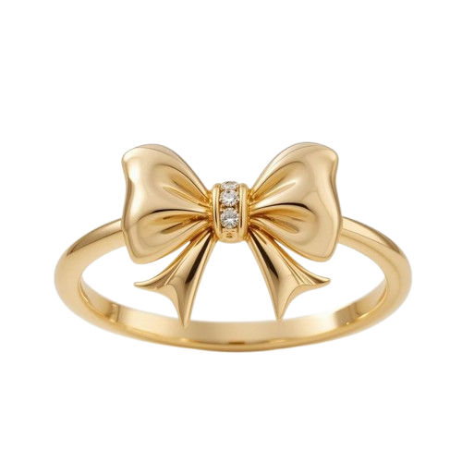

AAAAA
OUR SIGNATURE PRODUCTS:
Crimson Crush Lipstick
A bold, sultry red that commands attention. With rich pigments and a velvety matte finish, Crimson Crush is your go-to shade for power, passion, and pure glamour.

Slide 12
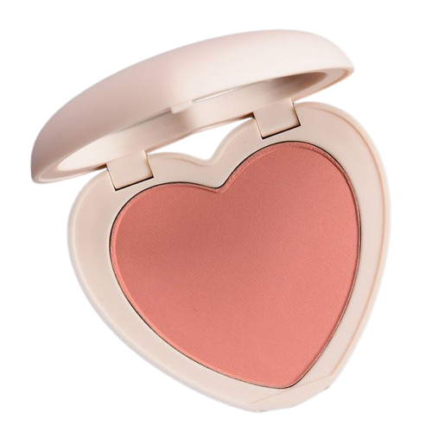
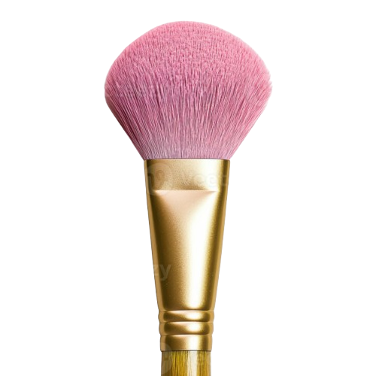

AAAAA
OUR SIGNATURE PRODUCTS:
Ethereal Knot Ring
A delicate twist of gold capturing timeless elegance. The Ethereal Knot symbolizes endless connection — light, graceful, and effortlessly divine.

Slide 13
AAAAA
USER EXPERIENCE
OUR SIGNATURE PRODUCTS:
🛒 Add to Cart – Instantly add products from the listing with a single click, just like premium shopping platforms.
🧭 Smooth Navigation – Clean layout and simple tabs make exploring the site fast, easy, and satisfying.
✉️ Contact Form – A styled, accessible form where users can ask questions, give feedback, or reach out anytime.
❓ Helpful FAQ – Clear answers to common concerns like shipping, payment, and returns — no confusion, no delays.
🖥️ Boutique-Like Feel – Designed to feel like a luxury store, whether you're browsing on phone, tablet, or desktop.
Coral Mist Blush
A soft, dewy coral with a whisper of peach. This blush blends seamlessly to give your cheeks a natural, radiant flush — perfect for a fresh, everyday glow with subtle warmth.

Slide 14
USER EXPERIENCE
OUR SIGNATURE PRODUCTS:
🛒 Add to Cart – Instantly add products from the listing with a single click, just like premium shopping platforms.
🧭 Smooth Navigation – Clean layout and simple tabs make exploring the site fast, easy, and satisfying.
✉️ Contact Form – A styled, accessible form where users can ask questions, give feedback, or reach out anytime.
❓ Helpful FAQ – Clear answers to common concerns like shipping, payment, and returns — no confusion, no delays.
🖥️ Boutique-Like Feel – Designed to feel like a luxury store, whether you're browsing on phone, tablet, or desktop.
Coral Mist Blush
A soft, dewy coral with a whisper of peach. This blush blends seamlessly to give your cheeks a natural, radiant flush — perfect for a fresh, everyday glow with subtle warmth.
OUR FUTURE PLANS
💌 Email Signups & Beauty Drops – Exclusive early access to new collections, offers, and glam tips straight to inboxes.
🎨 Virtual Try-On Tool – A feature where customers can digitally try lipstick shades or jewelry before buying — fun, futuristic, and user-friendly.
📦 Subscription Box Option – Monthly curated glam boxes with bestselling or new products — a surprise in every delivery.
🎀 Collaboration Series – Limited collections co-created with influencers, makeup artists, or local creatives for hype and fresh buzz.

Slide 15
USER EXPERIENCE
🛒 Add to Cart – Instantly add products from the listing with a single click, just like premium shopping platforms.
🧭 Smooth Navigation – Clean layout and simple tabs make exploring the site fast, easy, and satisfying.
✉️ Contact Form – A styled, accessible form where users can ask questions, give feedback, or reach out anytime.
❓ Helpful FAQ – Clear answers to common concerns like shipping, payment, and returns — no confusion, no delays.
🖥️ Boutique-Like Feel – Designed to feel like a luxury store, whether you're browsing on phone, tablet, or desktop.
OUR FUTURE PLANS
A GLAMOROUS EXPERIENCE
💌 Email Signups & Beauty Drops – Exclusive early access to new collections, offers, and glam tips straight to inboxes.
🎨 Virtual Try-On Tool – A feature where customers can digitally try lipstick shades or jewelry before buying — fun, futuristic, and user-friendly.
📦 Subscription Box Option – Monthly curated glam boxes with bestselling or new products — a surprise in every delivery.
🎀 Collaboration Series – Limited collections co-created with influencers, makeup artists, or local creatives for hype and fresh buzz.
At Glamistry, we believe beauty is more than just a product — it's an experience. From the moment you land on our website to the second your package arrives, we aim to deliver elegance, ease, and enchantment. Every shade, shimmer, and sparkle in our collection is curated to make you feel confident, radiant, and uniquely you. Whether you're selecting the perfect lipstick or choosing a statement piece of jewelry, Glamistry transforms your everyday moments into something extraordinary. This is not just shopping — it’s self-love, luxury, and a touch of magic.

Slide 16

OUR FUTURE PLANS
💌 Email Signups & Beauty Drops – Exclusive early access to new collections, offers, and glam tips straight to inboxes.
🎨 Virtual Try-On Tool – A feature where customers can digitally try lipstick shades or jewelry before buying — fun, futuristic, and user-friendly.
📦 Subscription Box Option – Monthly curated glam boxes with bestselling or new products — a surprise in every delivery.
🎀 Collaboration Series – Limited collections co-created with influencers, makeup artists, or local creatives for hype and fresh buzz.
A GLAMOROUS EXPERIENCE
At Glamistry, we believe beauty is more than just a product — it's an experience. From the moment you land on our website to the second your package arrives, we aim to deliver elegance, ease, and enchantment. Every shade, shimmer, and sparkle in our collection is curated to make you feel confident, radiant, and uniquely you. Whether you're selecting the perfect lipstick or choosing a statement piece of jewelry, Glamistry transforms your everyday moments into something extraordinary. This is not just shopping — it’s self-love, luxury, and a touch of magic.
Idhar ayega glamistry ka logo
THANK YOU
Thankyou for being here! I’d love to know what you think — feel free to share your thoughts, ideas, feedbacks , or questions anytime!

Slide 17
THANK YOU
A GLAMOROUS EXPERIENCE
Thankyou for being here! I’d love to know what you think — feel free to share your thoughts, ideas, feedbacks , or questions anytime!
At Glamistry, we believe beauty is more than just a product — it's an experience. From the moment you land on our website to the second your package arrives, we aim to deliver elegance, ease, and enchantment. Every shade, shimmer, and sparkle in our collection is curated to make you feel confident, radiant, and uniquely you. Whether you're selecting the perfect lipstick or choosing a statement piece of jewelry, Glamistry transforms your everyday moments into something extraordinary. This is not just shopping — it’s self-love, luxury, and a touch of magic.
Idhar ayega glamistry ka logo

